Slide 1

Welcome!
CS/COE 0449
Jarrett Billingsley
don't you just feel great about the future?

Slide 2
Administrivia

Slide 3
hi
you can just call me Jarrett
jarrett@cs.pitt.edu
pitt.edu/~jfb42
I send announcements through courseweb which come thru email
announcements/grades are the only things I use courseweb for
everything else is on my site.
is it reasonable to take this class with 1501? maybe. depends.
also computers suck and the people who work with computers suck and get out while you can.
go grow plants.

Slide 4
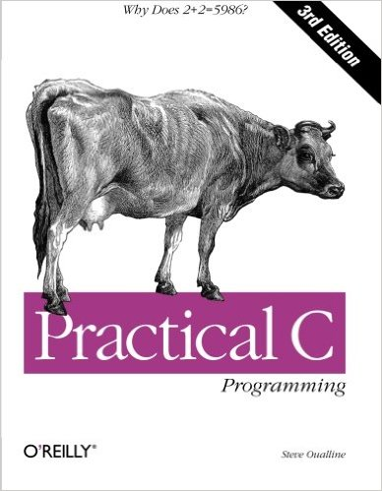
Textbook (optional)
Practical C Programming (Oualline)
it's an adorable time capsule
otherwise… meh
textbooks are a racket
pirate everything you can
Notes:
- very old-fashioned, shows some ways of doing things which aren't recommended today
- makes reference to things that aren't true anymore (like Windows not having memory protection)

Slide 5
Grading
there is no such thing as attendance
labs: 10%
graded on effort/completion
projects (x 4): 50%
lowest grade is weighted 5%, others 15%
exams: 40%
lowest grade worth 15%, other 25%
must get at least a 75% to get a C, in order to pass
Notes:
- 5 projects is too much.

Slide 6
Expectations
religious absences: contact me ASAP
students with disabilities: contact the DRS ASAP
jokes/comments about sex, gender, race, ethnicity, religion, etc. are inappropriate for class, emails, office hours, chats etc.
if someone is making you feel unwelcome/uncomfortable, please contact me or the TAs privately
if you are making someone feel unwelcome/uncomfortable the adult response is to accept responsibility and apologize
not to say "it was just a joke/meme" or "you're too sensitive"
have you considered being nice?
humans are rational and emotional.
consider others' happiness.
if you fail to acknowledge your own emotions, you are doomed to be controlled by them.

Slide 7
Teaching philosophy
you are a student. you’re supposed to be confused.
I wanna help you understand!
No questions are dumb!
Never be afraid to ask them!
DON’T STRUGGLE IN SILENCE ON YOUR PROJECTS/LABS!!!!!
what is a university setting good for today?
focus, practice, and access to people who know stuff
in other words, me
it is my job to teach you, please let me do my job
Notes:
- "teaching" does not mean "standing up at the front of the room and reading off a slide deck"
- teachers who do that and nothing more are bad teachers.
- I am the most important resource available to you.

Slide 8
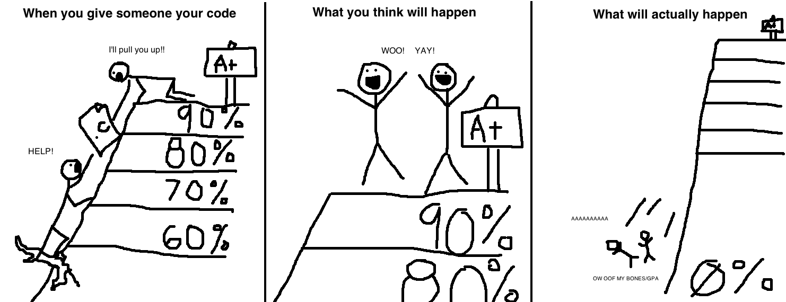
I can tell when you cheat :^)
first cheat, fail the assignment; second cheat, fail the class.
don't post your code on github
don't "help" your friends by giving them code
Notes:
- if you "help" a friend, you are only delaying their failure until a later point when it will be too late to fix the problems.
- a 0 will hurt way, way more than a 60, and it'll hurt you both.
- don't cheat if your enrollment is contingent upon your GPA. or your ROTC training or your student visa or whatever.

Slide 9
That being said…
I trust you!
I try to be accommodating about extensions and such
I don’t think most cheaters are being lazy
but you’re an adult, and are responsible for your actions.
if you're confused, don't cheat, ask me for help.
again, that's what I'm here for??????????
you can work with one partner on projects as long as…
you inform me ahead of time,
and you do not share code!

Slide 10
Hello, world

Slide 11
splashhhhh 💦
let's jump in the the C swimming pool (code examples are on the site)
#include <stdio.h>
int main() {
printf("Hello, world!\n");
return 0;
}
what things are similar to Java?
what things are different?
what do you suppose those new things do?
Notes:
+ syntax looks similar (braces, semicolons, keywords)
+ we use some kind of "print" function to write to the console
+ we have "int"
- there's #include, which probably works something like import - main returns a number for some reason
- there's no String[] args on main
- there's no class

Slide 12
Falling down the rabbit hole
if you compile that C program, you get an executable file
what does that executable file contain?
what happens when you run it?
how does the program actually make things happen?
how do programs control all the computer hardware?
how do multiple programs run at the same time?
that's what this course is all about.

Slide 13
Oh yeah, gcc
gcc is the C compiler we'll be using (the C analogue of javac)
to compile name.c to a program called name:
gcc -o name name.c
if you just do gcc name.c the output will be named a.out
-o name is a single thing; don't put anything between them!
you might see me type
gcc -Wall -Werror --std=c99 -o name name.c
the up/down arrows on your keyboard go through recent commands!
Notes:
-Wall and -Werror are good habits – catch lots of errors which would otherwise go unnoticed

Slide 14

Oh yeah, thoth
thoth is a server we've set up for you to do your work.
you connect over the internet with ssh to run commands on it
internets
you
thoth
this isn't quite set up yet, but it will be shortly.
your first lab will walk you through all this!
Notes:
- there is only one thoth and many of you (and many sections of 449)
- your files are stored in a third place called AFS, which is universal to pitt (and in fact many institutions)
[diagram: your computer and thoth are connected over the internet.]

Slide 15
C Basics

Slide 16

Appearances can be deceiving
C might look a bit like Java
but it sure doesn't behave the same way
int x = 5;
printf("The value of x is: " + x);
what does this print?
oh.
webcomicname.com
Notes:
- it prints "alue of x is: "
- if you change x, it changes where in the string it starts printing, but never prints x

Slide 17

The training wheels are off
C is weird and prickly and unforgiving and like 50 years old
you will probably hate it
but like this flower and the weird bird that matches it, C and modern computers have coevolved
understanding C is understanding how modern computers work*
Notes:
* kiiiiiiiind oooooooooooooooooof. it's understanding how we think modern computers work but really there are like five more levels of abstraction below that, lol
[photo: a bird with a strangely shaped beak and a flower whose shape matches it perfectly]

Slide 18
Which C?
C89 (ANSI C)
most portable, but annoying
C11
new features not relevant for us here
we'll stick with C99 for this course.
gcc --std=c99 ...
Notes:
- MS decided to never implement C99 so if you want to write C programs that work on all platforms, you're stuck with ANSI C
- or maybe that is changing? idk what MS is even doing anymore

Slide 19

OOPs
Java is OOP: "object-oriented programming"
that's fine, but...
if someone tells you that their way of thinking will solve all your problems, they're lying.
part of being an engineer is knowing what tool is appropriate for the situation
OOP is not always that tool
C is not always that tool either!
OOP
Java
literally every programming problem
Notes:
- this is general life advice too
- people had OOP fever in the 90s and 00s, but we've come to realize that many of its features are more trouble than benefit
- single-paradigm languages are annoying

Slide 20
I'm gonna assume you know the following:
what mathematical operators are and do
how to declare variables
how to write numbers and strings
how integer and floating point arithmetic differ
how to write comments // with these /* and these */
if-else, while, do-while, for, and switch-case statements
what indentation is, why it's important, and how to do it
why are they not teaching this before me why
Notes:
- if you're fuzzy on any of these, ask me

Slide 21
Anti-patterns
break these habits.
if(a == b)
first();
else if(a != b)
second();
if(a == b)
first();
else
second();
if(a == 1)
first();
if(a == 2)
second();
if(a == 1)
first();
else if(a == 2)
second();
Notes:
- first one: that's what else is for. it's the code that's run if the "if" condition is false.
- second one: there's a big difference between "sequence of ifs" and "if-else if". think about it. draw it out.

Slide 22
break and continue
for some reason many instructors never teach these!
if you want to leave a loop, use the break statement.
int index = -1;
for(int i = 0; i < length; i++) {
if(array[i] == thing) {
index = i;
break; // instantly stops looping.
}
}
if you want to go to the next iteration of a loop, use continue.
not as common, but maybe you wanna skip something.

Slide 23
Input and output

Slide 24
It's a lot shorter than System.out.println()…
instead of using + like in Java…
we use a format string with format specifiers
int x = 5;
printf("The value of x is: %d\n", x);
Specifier | Type
%d | int
%f | float
%s | string
%c | char
Escape | What it is
\n | newline
\t | tab
\\ | \
\a | DING!!!
Notes:
- you can absolutely use the "wrong" specifier
- if you have -Wall on, it will complain, but otherwise, it will compile and run and do weird shit

Slide 25
One big difference with variables in C…
int x;
printf("The value of x is: %d\n", x);
what will it print?
answer: you don't know.
uninitialized variables in C can contain any value.
maybe 0!
maybe 2385!
maybe -100000!
use gcc -Wall -Werror
Notes:
-Wall catches so many things that are absolutely errors, it's just that C lets you do virtually anything

Slide 26
The beginning of the weirdness
how do you get a line of text input in Java with a Scanner?
String input = someScanner.nextLine();
it's… a little different in C
char input[100];
fgets(input, 100, stdin);
let's pick this apart

Slide 27
A local array
here's something that doesn't exist at all in Java: char input[100];
it's an array of 100 chars, but…
it works like a local variable
it disappears when this function exits!
this can be dangerous
you will see local arrays used often in C
Notes:
- dangerous because you can hand off that array to someone else, and then it can disappear, and then who knows what will happen when they use it

Slide 28

f'getsaboudit
then we have this function call: fgets(input, 100, stdin);
fgets = file get string
that is, get a string (a line) from a file
stdin is C's name for what Java calls System.in
here we see another common C pattern:
rather than fgets giving us an array…
we ask fgets to fill in an array that we created
main()
fgets()
char input[100];
Notes:
- like buying a bottle of water vs. carrying your own reusable one
- java is like buying a bottle of water
- this is like carrying your own
- but you have to watch out who you give your bottle to, and make sure they don't overfill it!!
[diagram: the main function has an array of 100 characters named input. it passes that array to fgets. fgets gets the characters from the keyboard, and puts them directly into main's input array.]

Slide 29
But what's wrong?
when I type my name into 1_fgets.c…
it says
Hello, Jarrett
!
what's wrong? why is the ! ending up on the second line?
hmmm ;)

